Slide 1
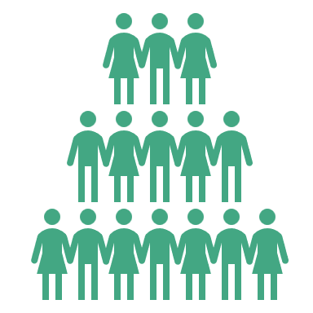
MD Considers Policy That Favors Corporate Giants
While the largest retailers in Maryland will rake in tens of millions from a new card processing
proposal, small businesses will see little benefit — and consumers could be the ones paying the price.
Recently, the Maryland legislature proposed a bill prohibiting card issuers and networks from imposing interchange fees on sales taxes and tips. This legislation has been falsely sold as helpful to small businesses.
In reality, 10 of the largest retailers in the country would grab 20% of the $59MM reduction in interchange fees on sales tax, and the 20 largest restaurant chains would take 19% of the $19MM reduction in interchange fees on tips.
The 668,365 small businesses in Maryland are expected to save just $89 each on average — and many would need to upgrade their payment systems to boot.
Large retailers would pocket the lion’s share of savings from the sales tax proposal.
Includes corporate megastores such as Walmart, Amazon, Home Depot, Target, and Lowe’s.
Note: Savings are from sales tax portion of the law only
Meanwhile, MD small businesses will save little, and many will face additional costs.
668k
$89
$1.2MM
Number of small
businesses in Maryland
99%
Average savings
per small business
Average savings per
top 10 business
Share of businesses in MD that are small businesses
Ultimately, consumers could end up paying the price.
After the federal government-imposed price caps on debit card interchange fees in 2011, only 1% of merchants passed the savings along to consumers by lowering their prices. Meanwhile, consumers suffered from higher fees, reduced services, and disproportionate harm to low-income consumers.
Note: See methodology on next page

Slide 2
Methodology
To calculate the impact of the proposed law in Maryland to eliminate interchange fees on sales taxes, EPC used the National Retail Federation’s (NRF) 2024 list of top 100 retailers (link). EPC narrowed the list to retailers with operations in Maryland and publicly available financial information on their domestic sales. For public companies on the NRF list, EPC estimated 2023 U.S. retail sales using financial data published in company 10-K reports. For private companies on the NRF list, EPC relied on NRF’s estimate of U.S. retail sales. EPC also relied on the published figures from the Maryland state budget for estimated 2025 sales tax collection.
The interchange reduction per retailer estimate uses Maryland’s state sales tax rate and accounts for idiosyncrasies in Maryland’s sales tax law (e.g., a 0% sales tax rate on groceries and medication). Additionally, the calculation relies on data published by The Nilson Report and the Federal Reserve to estimate credit and debit interchange fees paid on sales taxes. The analysis assumes that the share of each company’s U.S. sales revenue generated in Maryland is proportional to the percentage of physical stores that reside within the state. For e-commerce retailers, EPC assumes that the share of each company’s U.S. sales revenue generated in Maryland is proportional to Maryland’s share of U.S. Gross Domestic Product (1.9%).
For the gratuity-specific portion of the law, EPC relied on published data from the Maryland Office of the Comptroller on company income for food and beverage businesses in FY 2023, focusing on business subcategories that are most likely to accept tips. To calculate tip revenue within each subcategory, EPC modified Toast’s estimate of the average tip rate in Maryland to account for the nature of the restaurant (traditional vs. fast-casual vs. fast food).
Other sources used:
U.S. Small Business Administration (2024), “Maryland Small Business Profile.”
Federal Reserve Bank of Richmond (2014), “The Impact of the Durbin Amendment on Merchants: A Survey Study.”
Nilson Report (2024), “Paper, Cards and Electronic Payments Made in 2023 with Projections for 2028.”
EPC (2023), “Out of Balance: How the Durbin Amendment Failed to Meet Its Promise.”
State of Maryland (2023), “Sales and Use Tax Tables.”
Toast (2024), “Toast Restaurant Trends Report: The Cost of Going Out to Lunch.”
National Restaurant Association (2023), “Maryland Restaurant Industry Impact.”

